Slide 1
SnakeOil Capital
HL VAN ZYL 17640296

Slide 2
Introduction
SnakeOil Capital is a long-only domestic equity strategy that tracks the FTSE/JSE Capped SWIX.
This presentation aims to provide clients with some perspective on relative risk, performance and fund positioning.

Slide 3
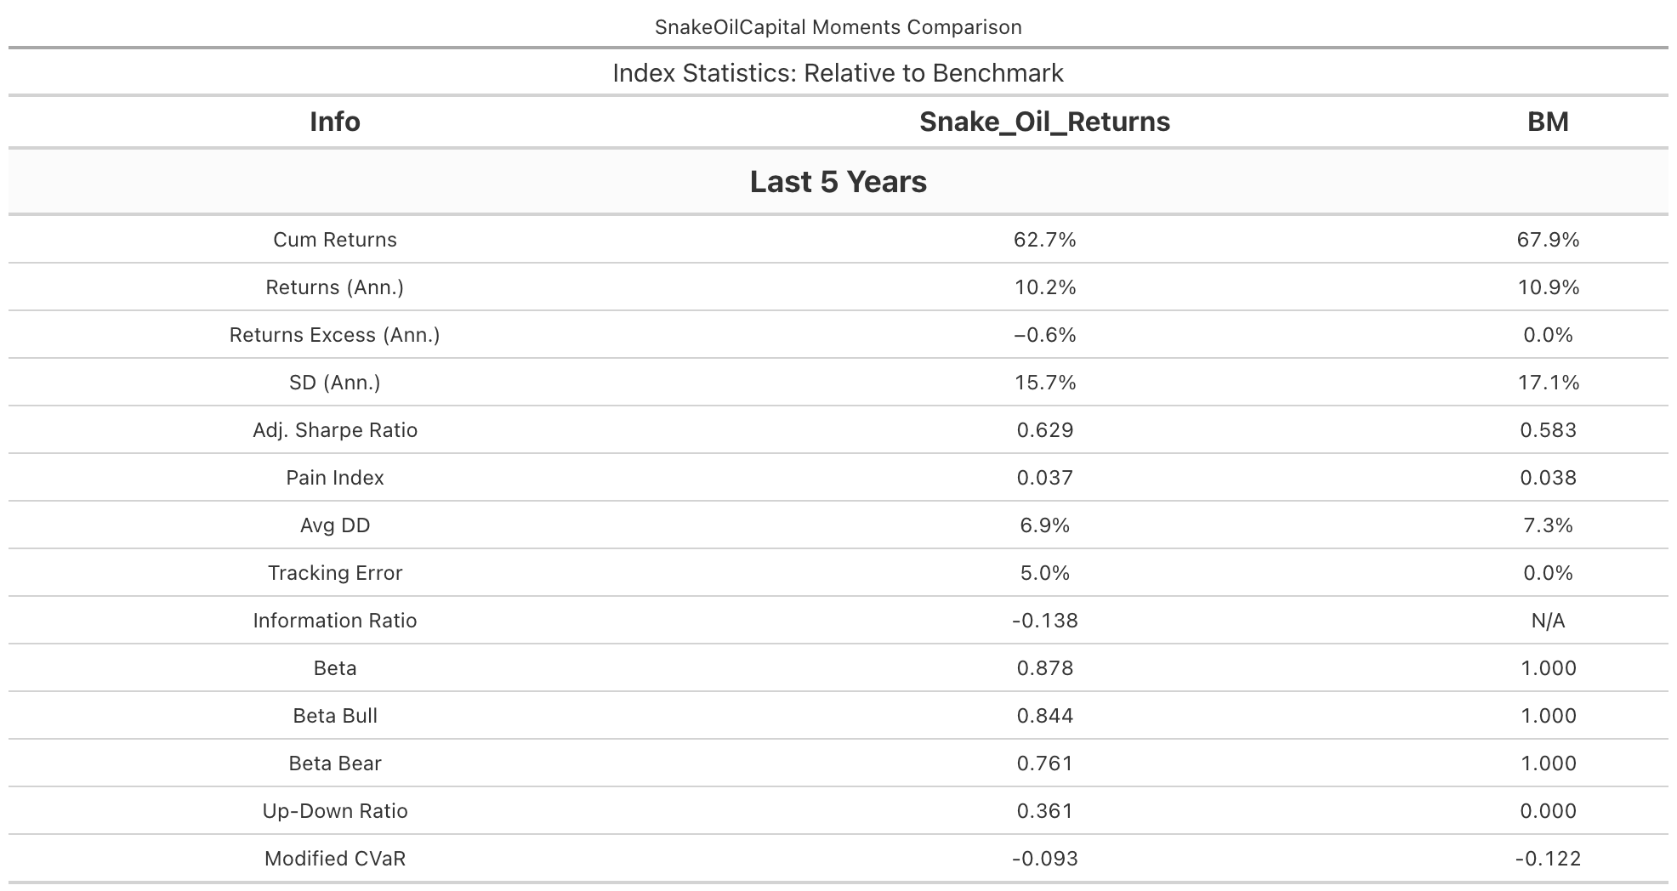
Broad summary
Here are a few important metrics to note regarding the performance of SnakeOil relative to the benchmark over the past 5 years.

Slide 4
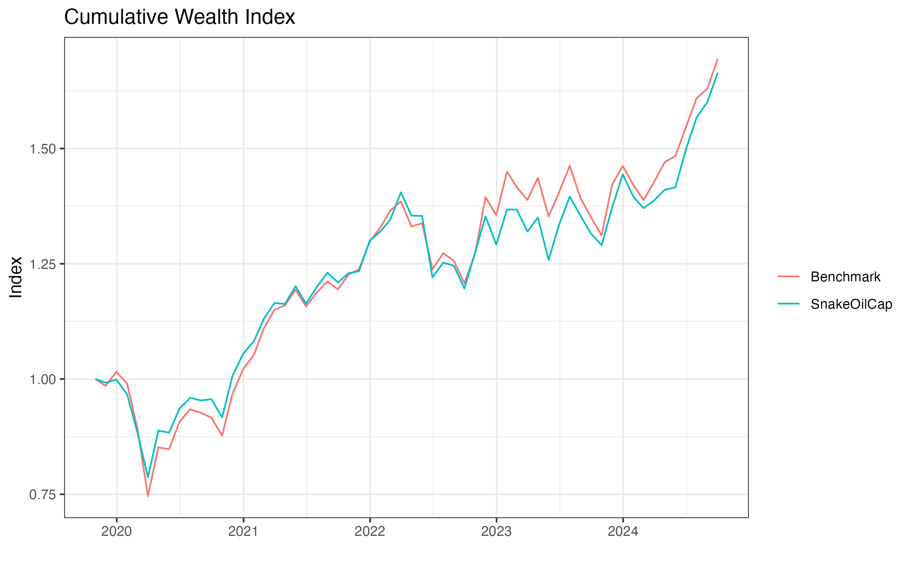
Performance
-Let’s look at the relative performance of cumulative returns. -It seems SnakeOil’s Strategy worked well during times of uncertainty (Covid). -Once the economy returned to normality the benchmark started to outperform.

Slide 5
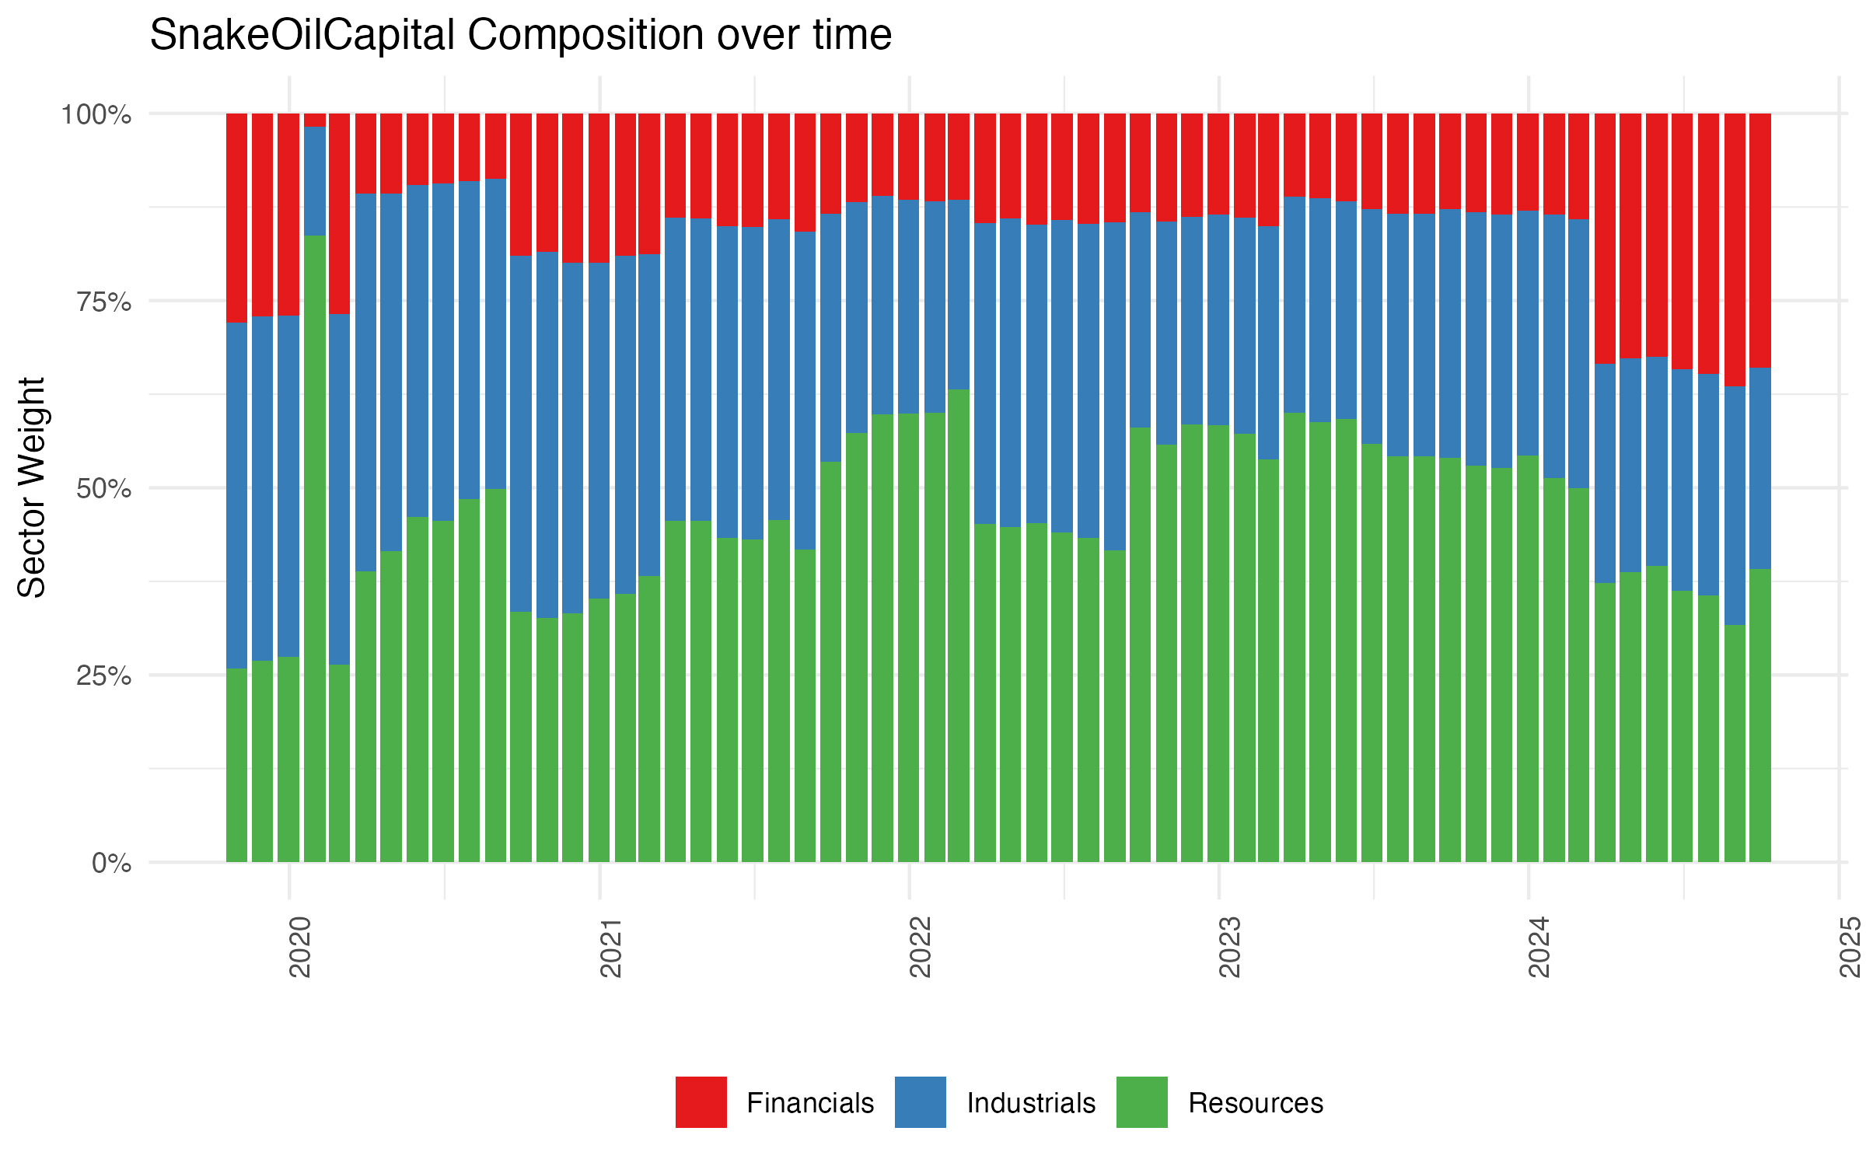
Fund Positioning
-This provides an idea of the systematic reweighting across sectors. -Financials have increased and resources have decreased in relative weighting in the last 6 months.

Slide 6
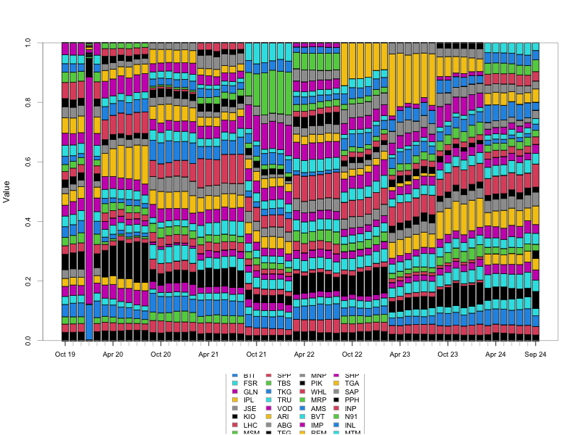
Fund Positioning
-This illustrates how the composition of stocks in the SnakeOil portfolio have been updated over time

Slide 7
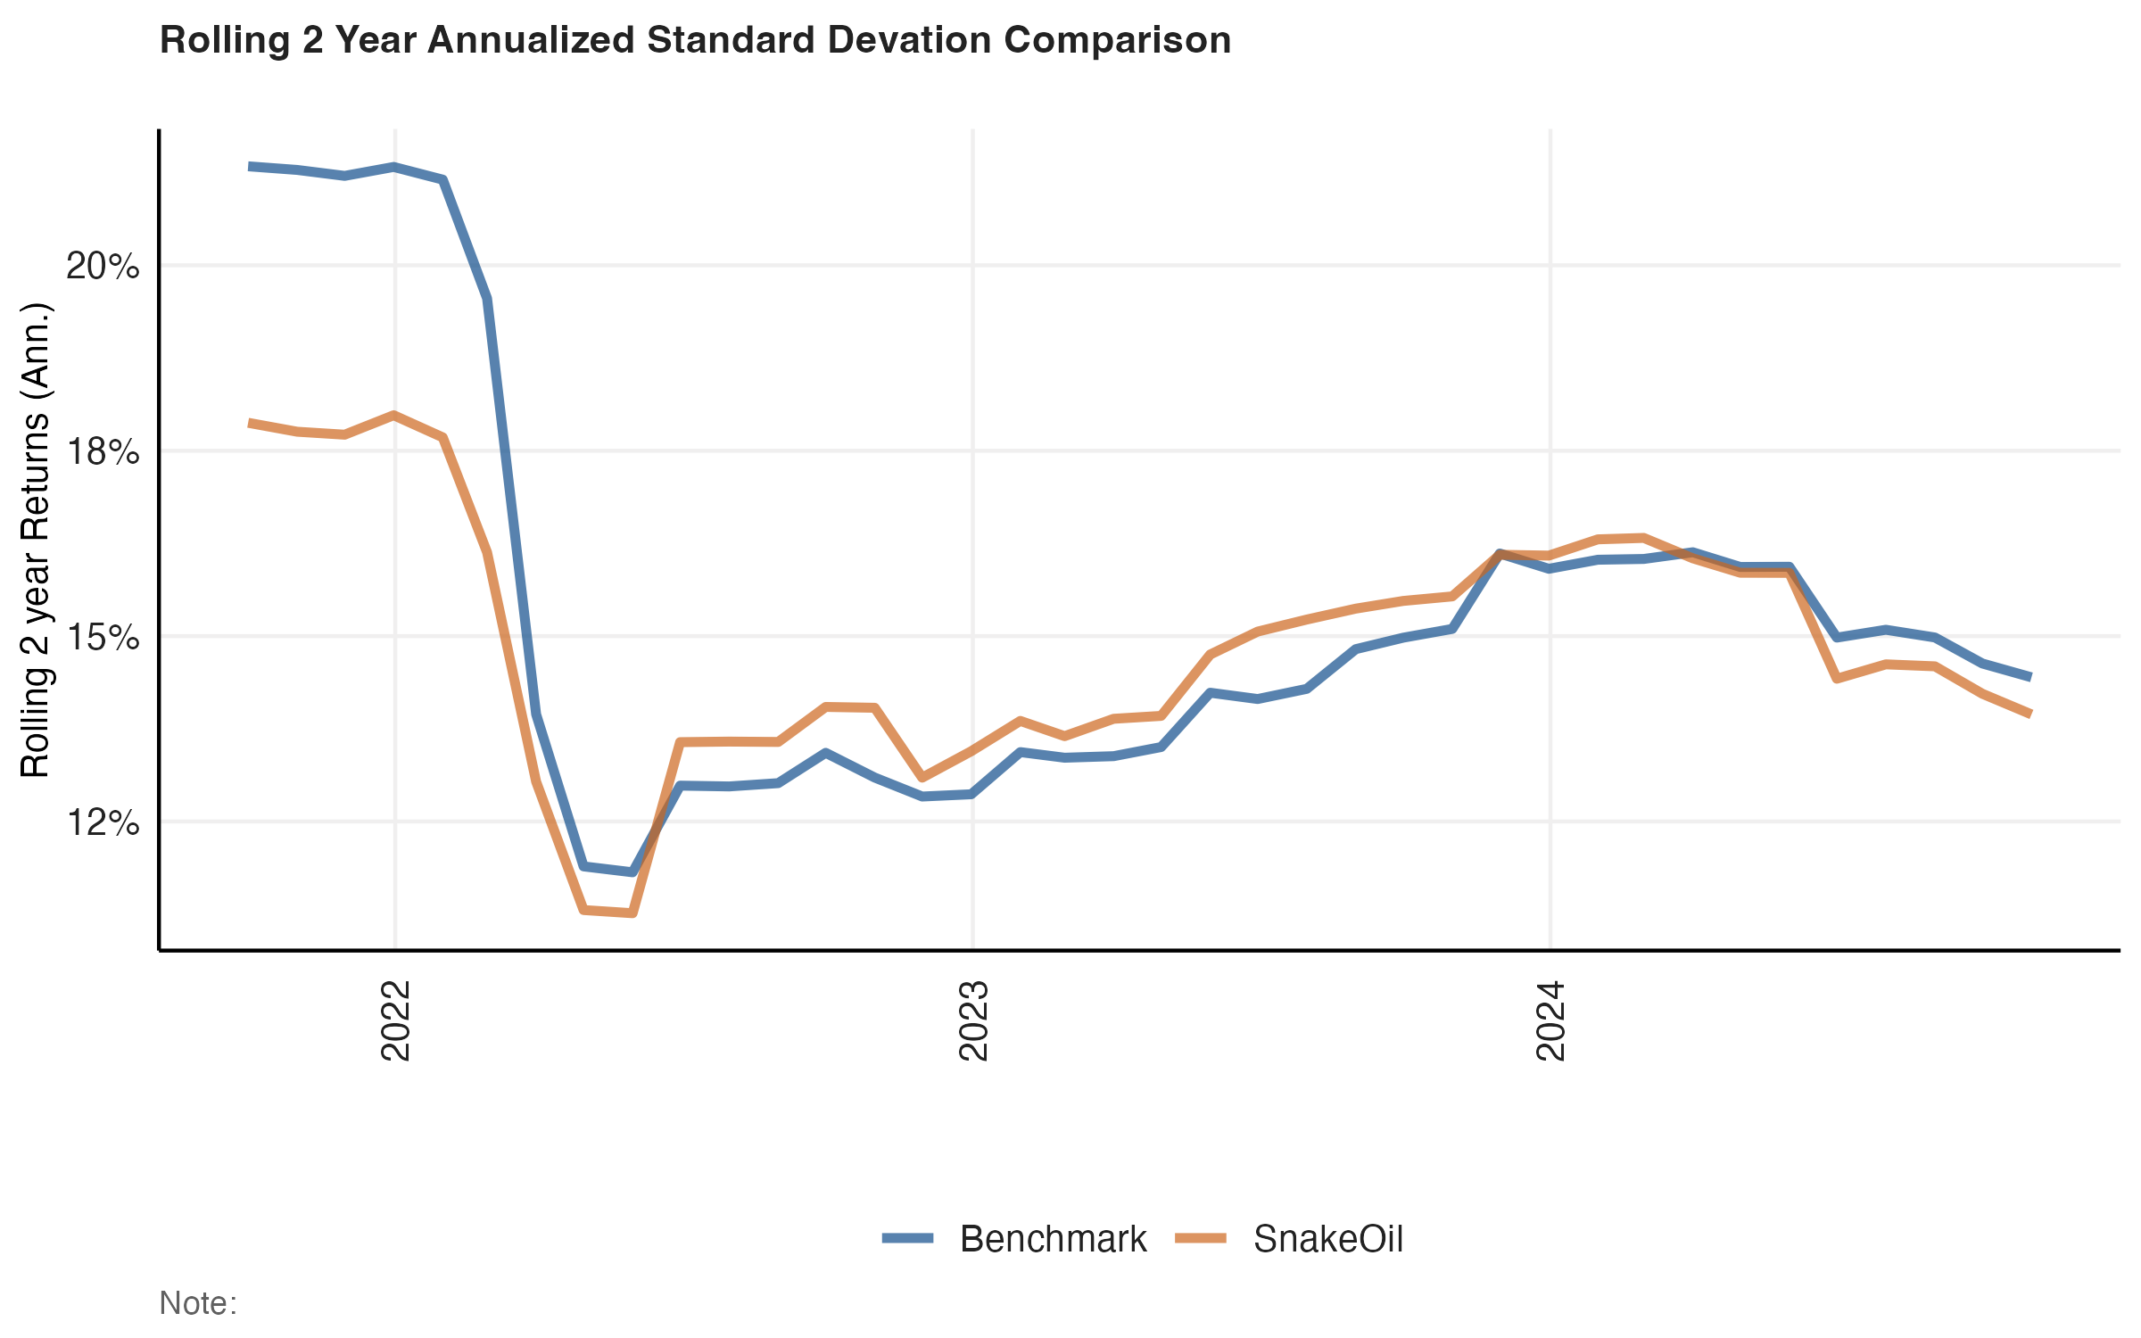
Risk Measures
-This supports the earlier claim that the SnakeOil Fund had comparatively lower volatility during a period of high uncertainty in global market (Covid)

Slide 8
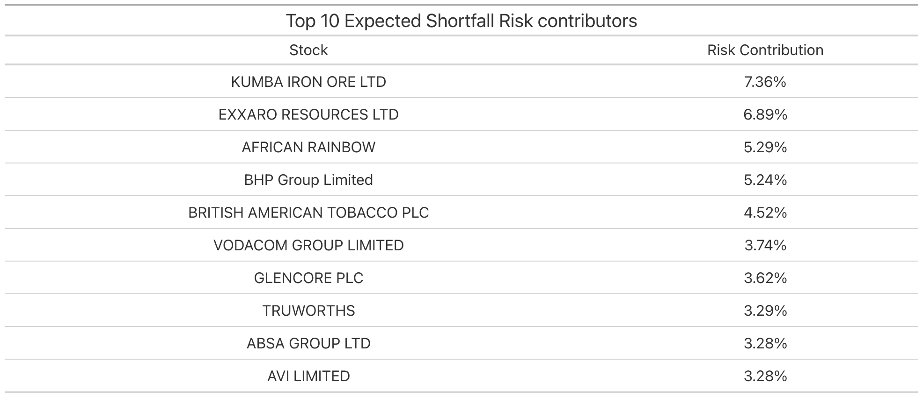
## Top Contributors to risk
These 10 Stocks contributed most to Expected shortfall during the last 5 years.

Slide 9
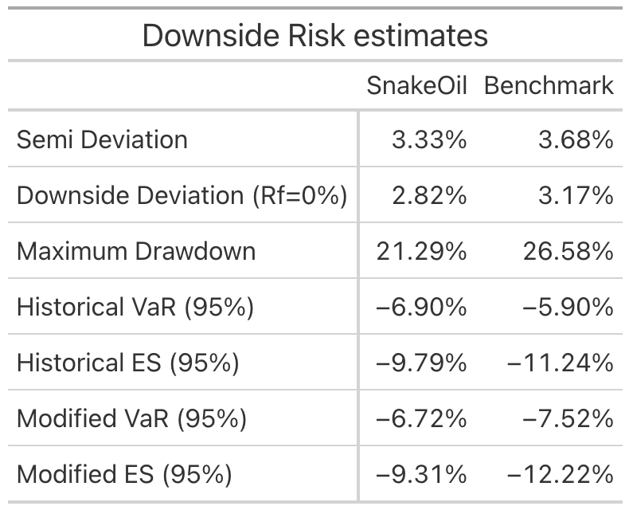
Downside risk comparison

Slide 10
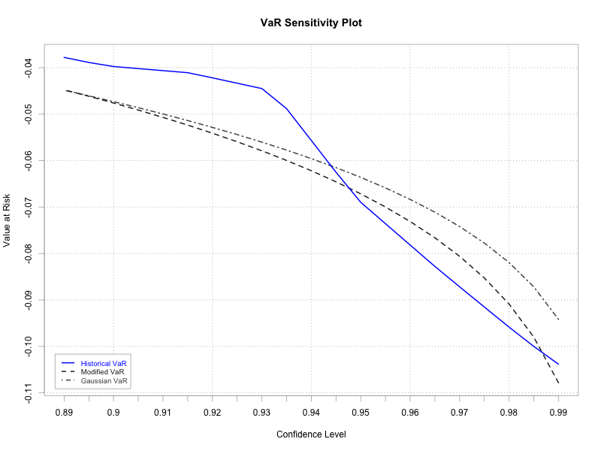
Value at Risk

Slide 11
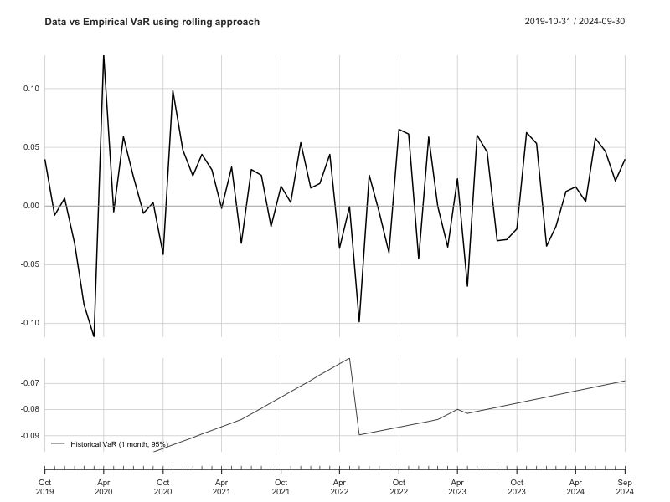
Rolling Value at Risk

